Slide 1
AsterixDB SQL++ Wrapper
Interface Comparison

Slide 2
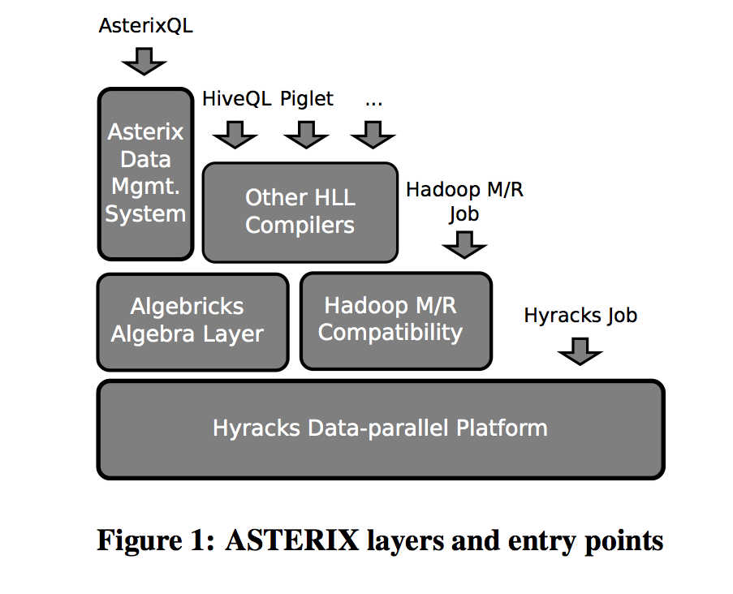
Three interface options available
Three ways to communicate with Asterix :
AQL : the AsterixDB query processor will translate AQL queries into an Algebricks DAG.
Algebricks DAG: Algebricks optimizes it according to rewriting rules and outputs a Hyracks job specification.
Hyracks job specification
Note : Hadoop M/R jobs have not been investigated.

Slide 3
AsterixDB wrapper implementation
SQL++ Query
AST
: layers that the AsterixDB wrapper may process.
Initial Query Plan
: layers that the AsterixDB wrapper may not.
Source Agnostic Rewritings
Source Annotation
Source Specific Rewritings
Physical Plan Generation
Native Query Generation
Plan Execution

Slide 4
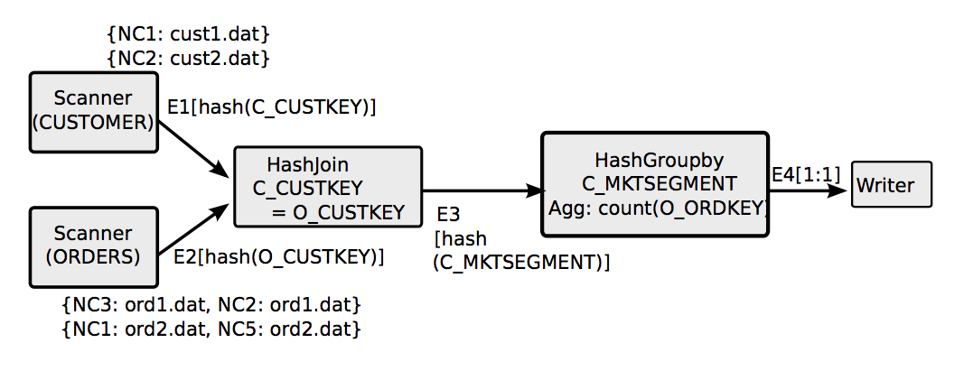
Example Query Translation
for $c in dataset Customers
for $o in dataset Orders
where $c.cust_key = $o.cust_key
group by $segment := $c.mkt_segment with $o
return {
"orders" : count($o),
"segment" : $segment
}
Example AQL query
SELECT C.mkt_segment AS segment, count (O.orderkey) AS order_count
FROM Customers AS C
JOIN Orders AS O
ON C.cust_key = O.cust_key
GROUP BY C.mkt_segment *
Example SQL++ query
Plan available here (section 2.3, logical plan)
Example Algebricks DAG
*: query taken from the Hyracks paper
Example Hyracks Job Specification

Slide 5
Algebricks
Pros :
Logical Operator DAG interface => closest interface to output of source annotation layer.
Port of another query compiler (Facebook Hive) that generates Algebricks DAGs already exists (dubbed Hivesterix).
Takes care of the optimization, parallelization and code generation into runnable Hyracks operators.
Cons:
Hivesterix is no longer maintained. It is not clear how easy it will be to interact with Algebricks in the future.
Not very well documented.

Slide 6
Hyracks
Pros :
Finest grain control over query processing.
Will generate the smallest amount of computation overhead on the Asterix side.
Cons:
Requires knowledge of the data distribution of the Asterix cluster.
Requires a mapping from SQL++ logical operators to Hyracks physical operators.
Requires implementing our own physical query optimizations.

Slide 7
AQL
Pros :
Most well known and well maintained AsterixDB interface.
Handles optimization, parallelization and code generation.
Cons:
Requires a mapping from SQL++ logical operators to AQL query constructs.
May introduce the largest amount of computational overhead.

